Slide 1
MySql Concrete Architecture (Storage Management)
November 1, 2017

Slide 2
Team
Ante Pimentel
Dusan Birtasevic
Francis Okoyo
Hashim Al-Helli
Richard Van

Slide 3
Introduction
This presentation illustrates the divergences between the conceptual and concrete architecture of a system.
Our topic of interest is the storage management component of the MySQL Server.
The learning outcome of this presentation is a better understanding of why certain differences exist between architectures.

Slide 4
Layout
Subsystems & Interactions
Derivation Process
Architecture Styles & Design Patterns
Storage Management
Architecture Differences
LsEdit Screenshots
Use Case
Lessons Learned

Slide 5
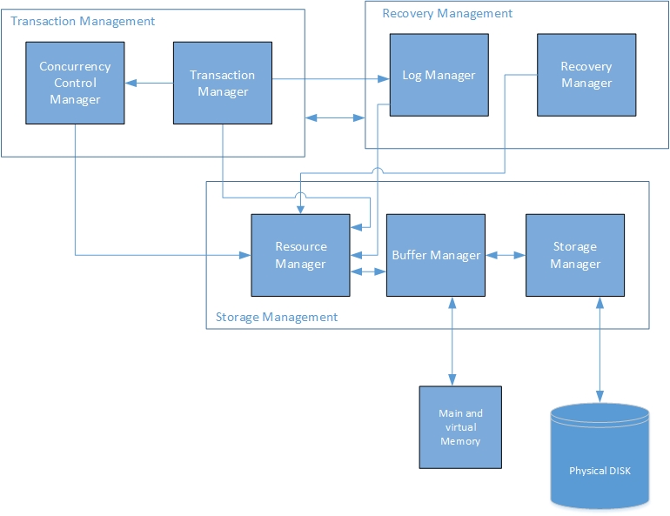
Subsystems and Interactions

Slide 6
Derivation Process
Visualized interactions using lsedit.
Simplified the view of lsedit by removing unneeded file dependences.
Analyzed the code structure and file names and tried to map file names to components.
If filename wasn’t clear we went inside the code and analyzed the comments.
When we found the right files, we contained and visualized them.

Slide 7
Some Important files in MySQL Server Folder
client - command line client utility code.
sql - main folder of MySQL it contains the parser and optimizer,execution engine and handler to choose a storage engine and many other things.
sql-common - files that used by client and server.
storage - The storage engines like InnoDB and MyISAM are implemented here.
vio - virtual input output contains implementation of low level network I/O code.

Slide 8
Architecture Styles and Design Patterns
Layered architecture (top-level and Storage management internals)
Pipe-and-filter architecture (query processing)
Client-server architecture (application layer)
Facade design pattern. The file mysqld.cc acts as an interface between the client and the other components.

Slide 9
Storage Management - Storage Manager
Storage Manager
Responsible for providing fast read/write access to tablespaces and logs of the database.
fil0fil.cc located in the fil directory contains the implementation of the low-level file system. Contains the methods and structures needed to manipulate them.
fsp0fsp.cc located in the fsp directory takes care of the file space management, which handles the allocation of pages and keeps track of which files are used, open, and closed.

Slide 10
Storage Management - Buffer Manager
Buffer Manager
The Buffer Manager is responsible for efficiently storing the data in memory for manipulation
it accepts requests from the Resource Manager and decides how much memory to allocate.
The buffer manager is located in the buf directory.
buf0buf.cc file is the buffer pool, buf0flu.cc flush the buffer pool and buf0lru.cc contains the replacement algorithm that decides which blocks should be shifted back to disk.
buf0rea.cc calls the storage manager to initiate a file read.

Slide 11
Storage Management - Resource Manager
Resource Manager
The responsibility of the Resource Manager is to accept requests from the higher level layers and translate them into an appropriate format that can be understood by the Buffer Manager.
The resource manager is found inside the dict directory.
It can be seen from the diagram that there is a direct interaction between storage manager and resource manager where the resource manager skips the buffer and accesses the storage manager directly.

Slide 12
Architecture Differences: Sticky Notes
Which: dict0dict.cc (ResourceManager) -> fil0fil.cc (StorageManager) fil_make_filepath
Who: Kevin Lewis
When: Jan 17, 2014
Why: Refactoring. Consolidating several functions that make a filename.
Notes:
We used sticky notes as presented in class to explain the discrepancies between our conceptual and concrete architectures.

Slide 13
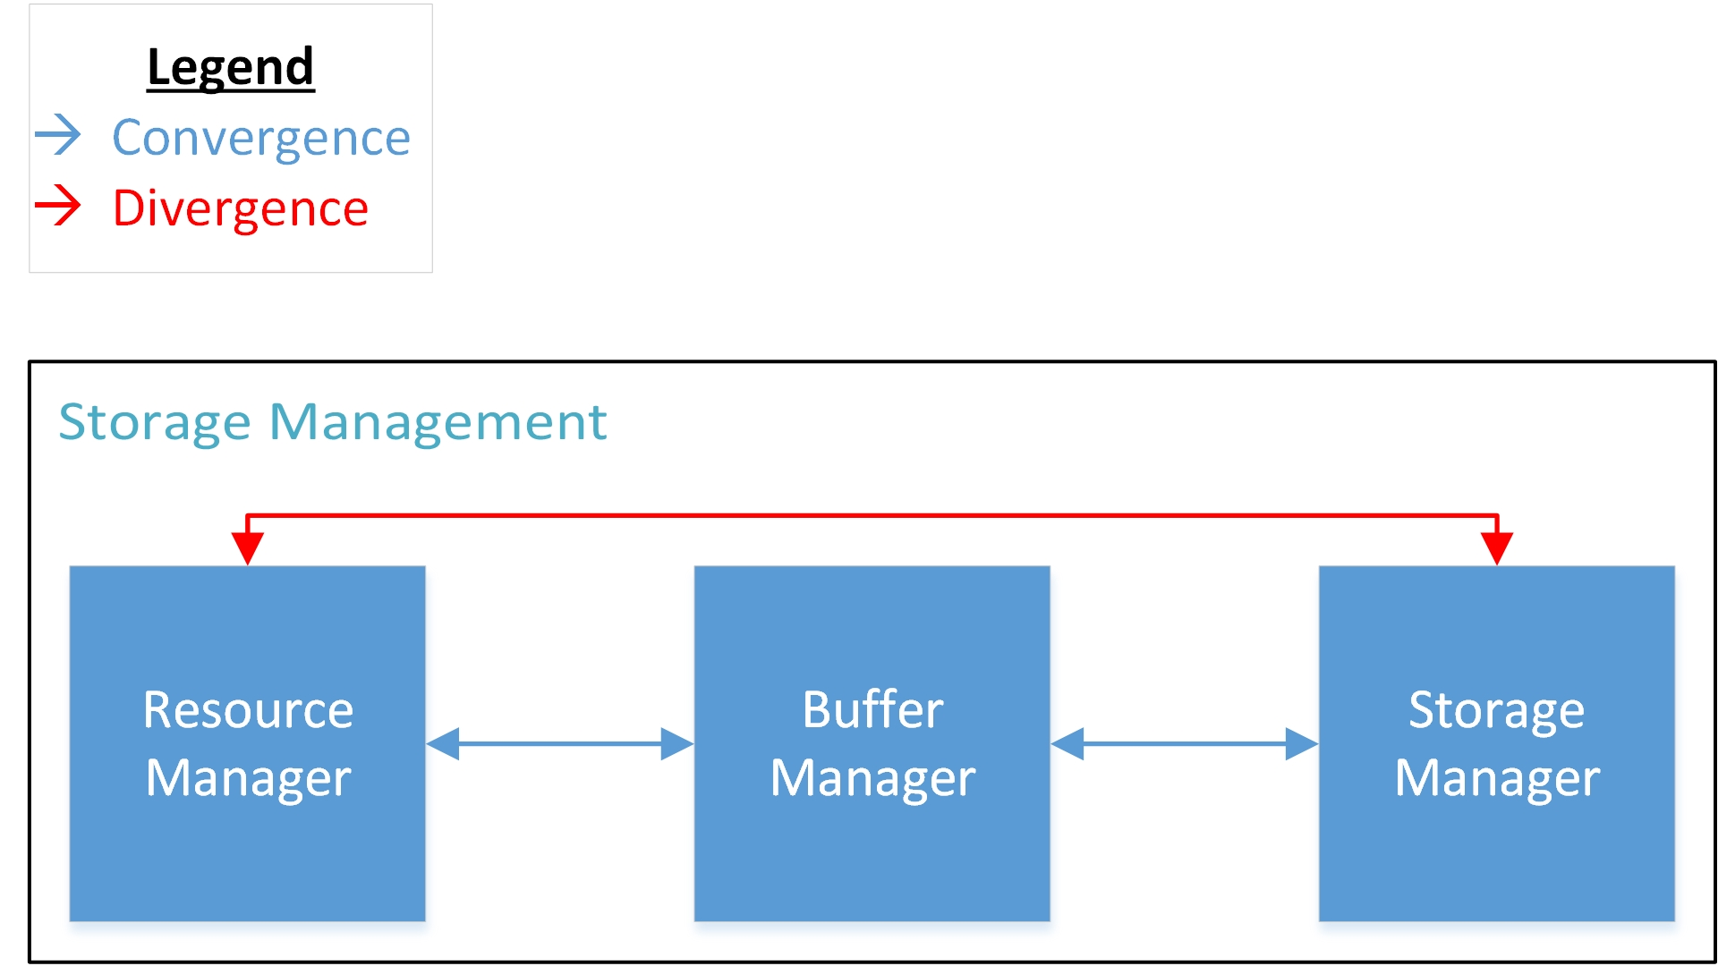

Slide 14
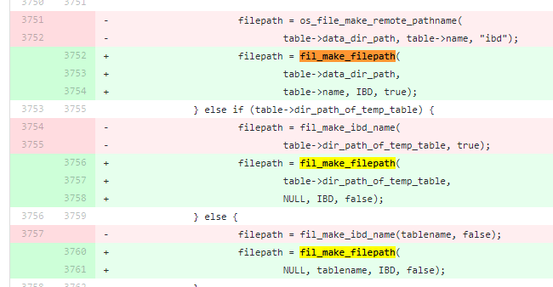
Architecture Differences
Notes:
https://github.com/mysql/mysql-server/commit/4b5f67c559c3567310f16917a5acaa18c9a93c33

Slide 15
Architecture Differences: Sticky Notes
Which: fil0fil.cc (StorageManager) -> dict0mem.cc (ResourceManager) dict_mem_create_temporary_tablename
Who: Jimmy Yang
When: Sept 5, 2012
Why: Bug fixing. Aborting an online add/drop column DDL prevents further DDL on that table.

Slide 16
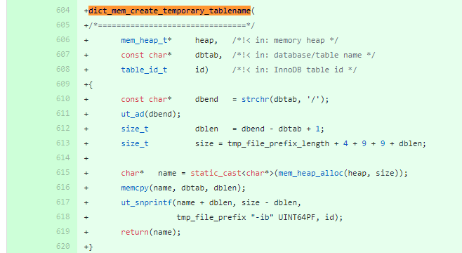
Notes:
https://github.com/mysql/mysql-server/commit/50b154910718c7513ffbf695f866af587a6fdffb

Slide 17
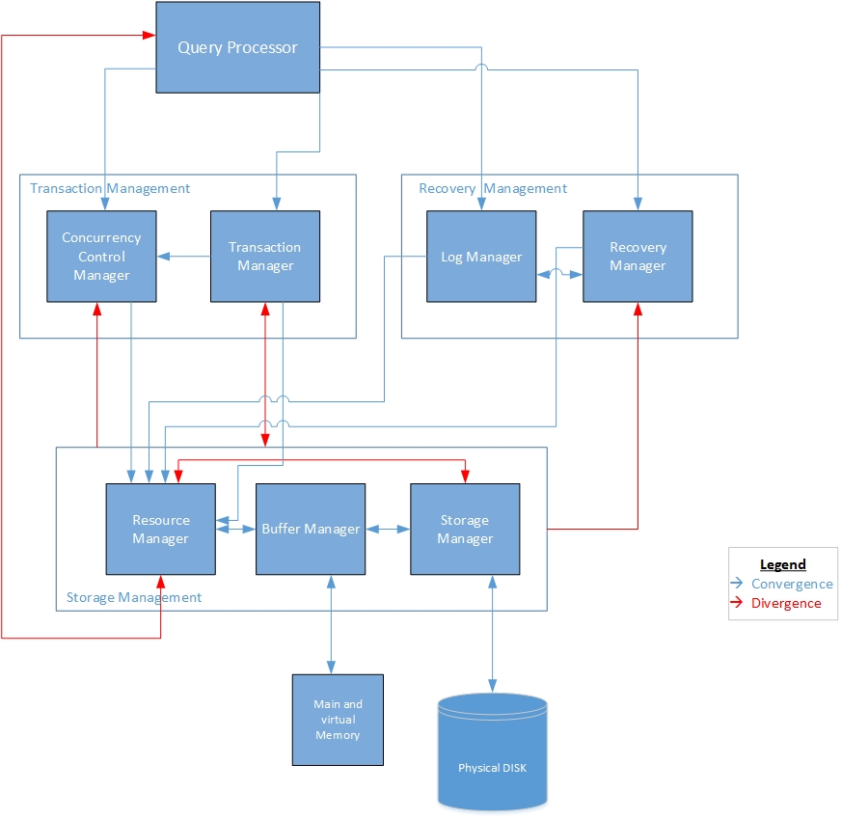
Side by side comparison: Conceptual and Concrete architectures

Slide 18
LsEdit Screenshots

Slide 19
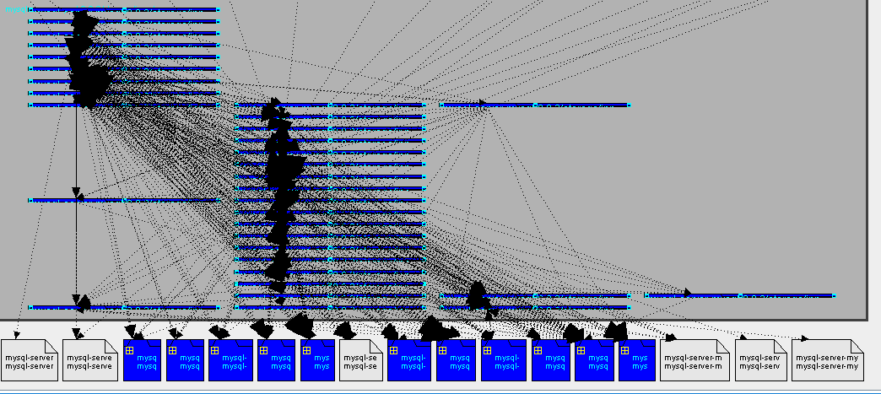
Notes:
Top level view of the MySQL architecture with the original containment file.

Slide 20
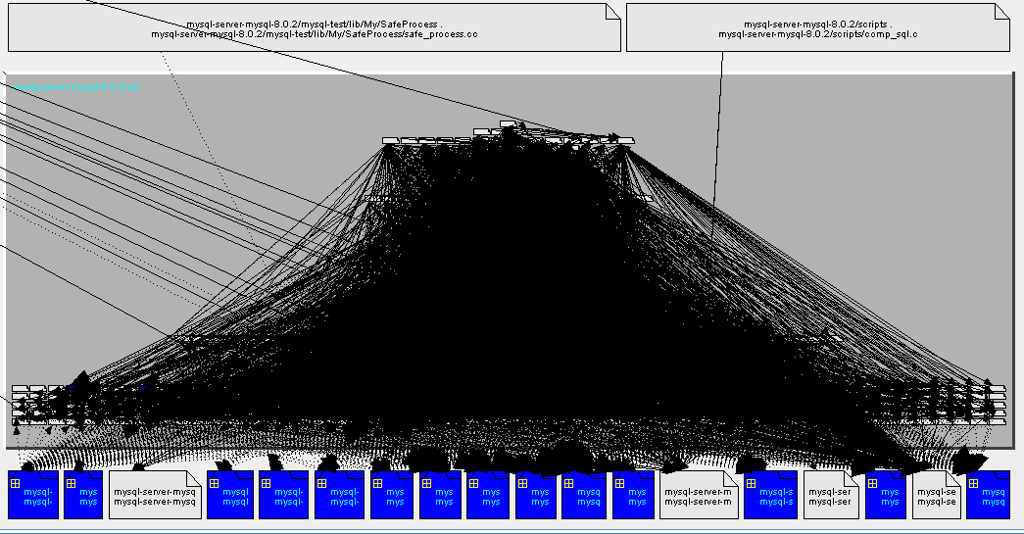
Notes:
“mysql-server-mysql-8.0.2/sql” subsystem view. There’s way too many dependencies to sift through; the need to refine the containment file can be shown.

Slide 21
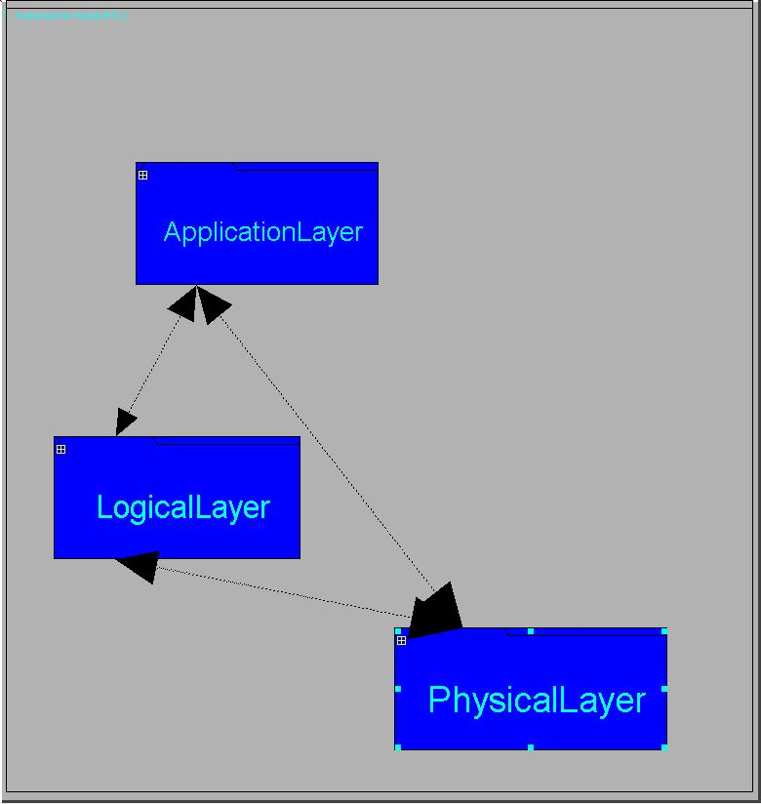

Slide 22
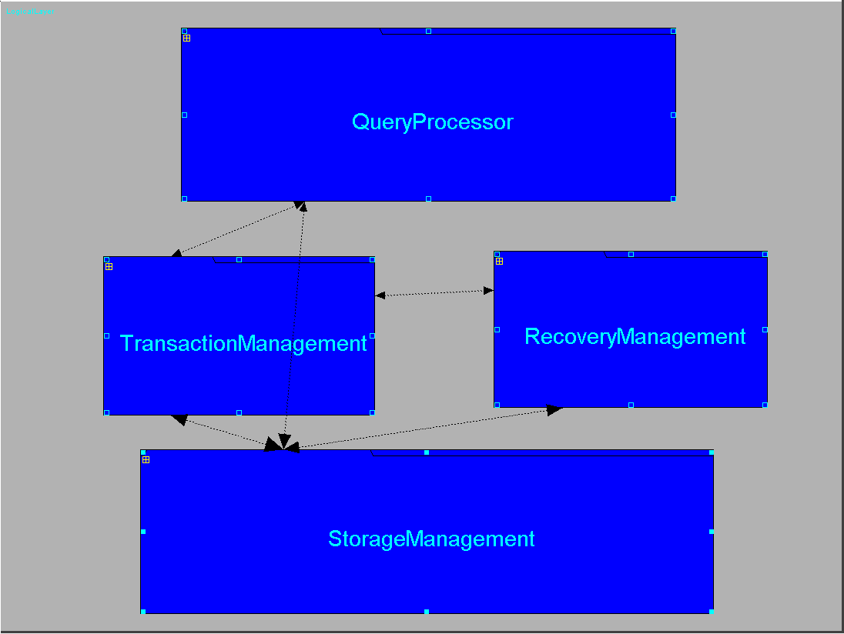

Slide 23
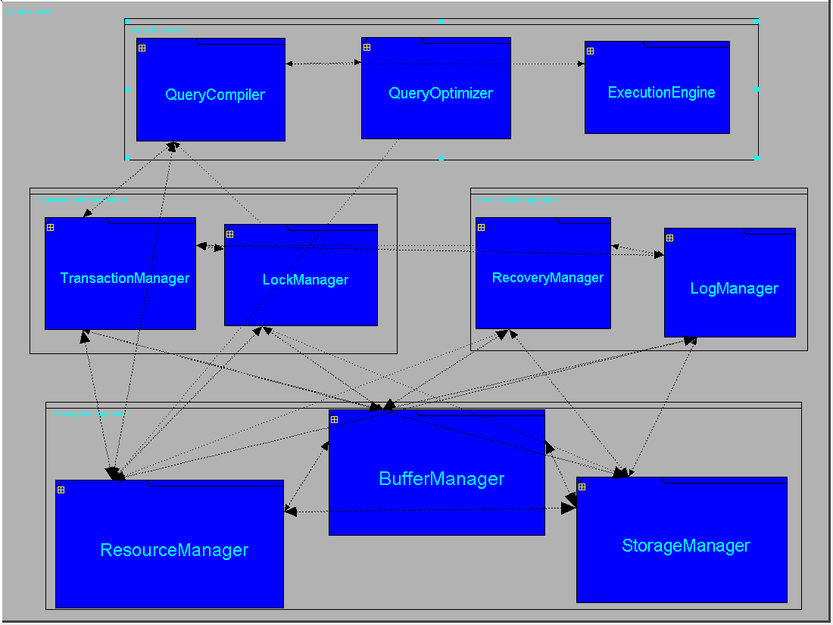

Slide 24
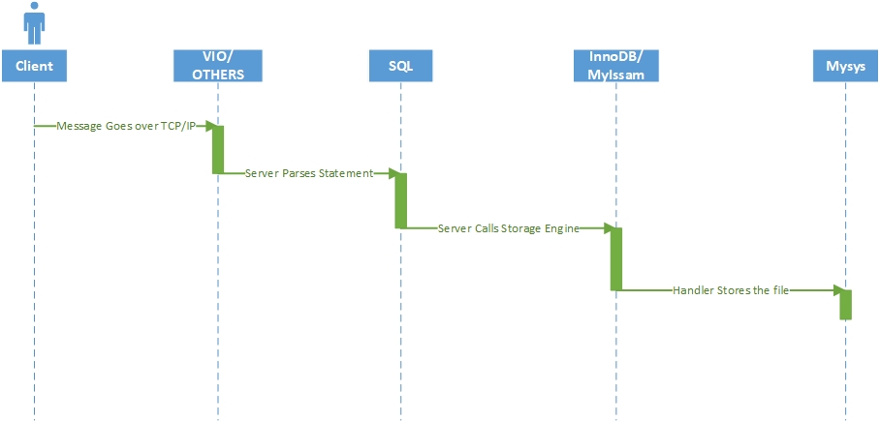
Use Case - INSERT Statement
Notes:
User enters insert statment
Message goes over TCP/IP
Server Parses the statement
Server calls the low level functions associated with the storage engine
Handler stores in the file.

Slide 25
Lessons Learned
Retrieving Concrete architecture of a good documented software is possible to achieve with less problems.
Concrete architecture may contain components that don’t exist in the conceptual architecture.
There are more interactions between components in the concrete architecture than the conceptual.
Lsedit is a powerful tool but not as user friendly.

